Slide 1
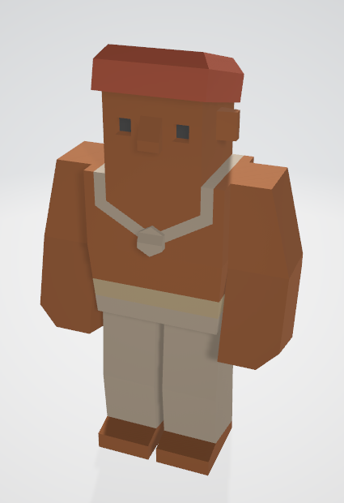
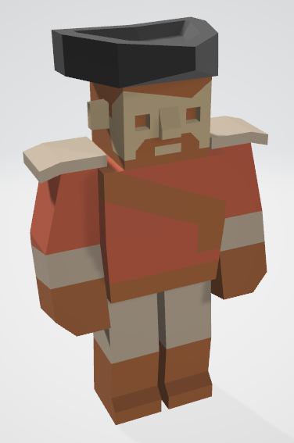
Level 6 – Group 3
Ship Happens
Tom Gibbs
Henry Crofts

Slide 2
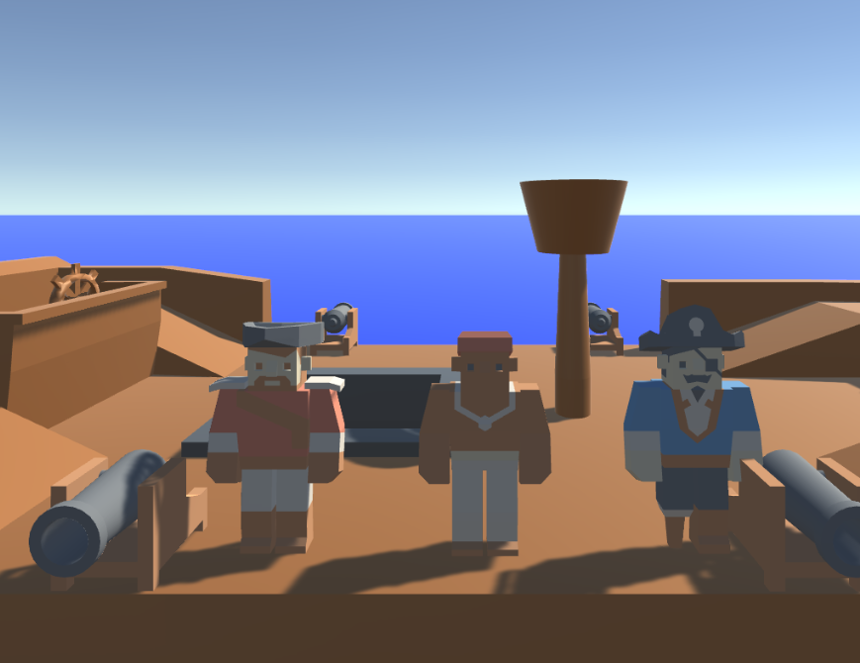
Logline
Local coop resource management game where players must coordinate to resolve hazards and manage activities, figuring out the optimal strategy

Slide 3
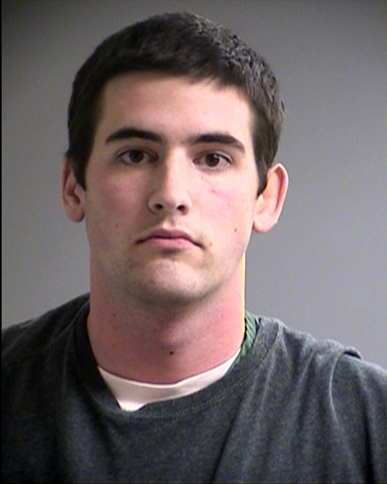
Psychographic
Terry Goldhorn
Aspiring Personal Trainer
Goal oriented / Targets / Progression
Social, plays games and goes out with friends
Student 20 y/o – Sport Sciences
Shared Accommodation
Morning Run / Lectures / Work / Evening Downtime

Slide 4
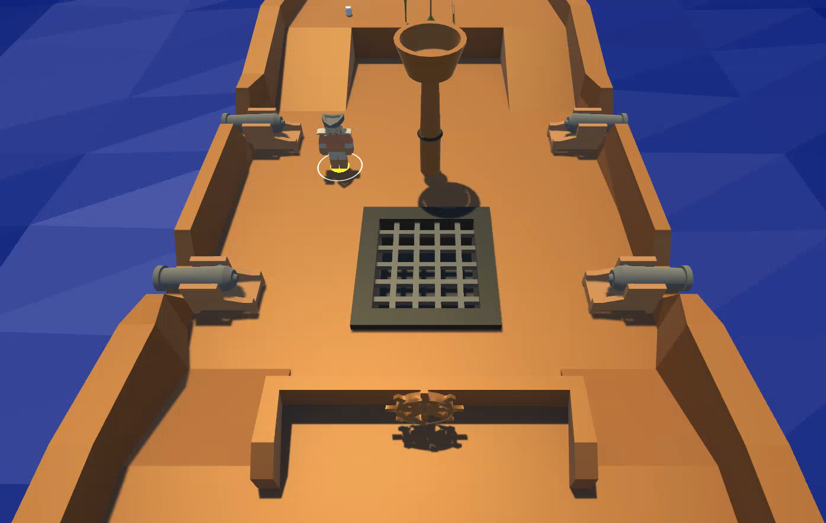
Ship Hold: Retrieve items

Slide 5
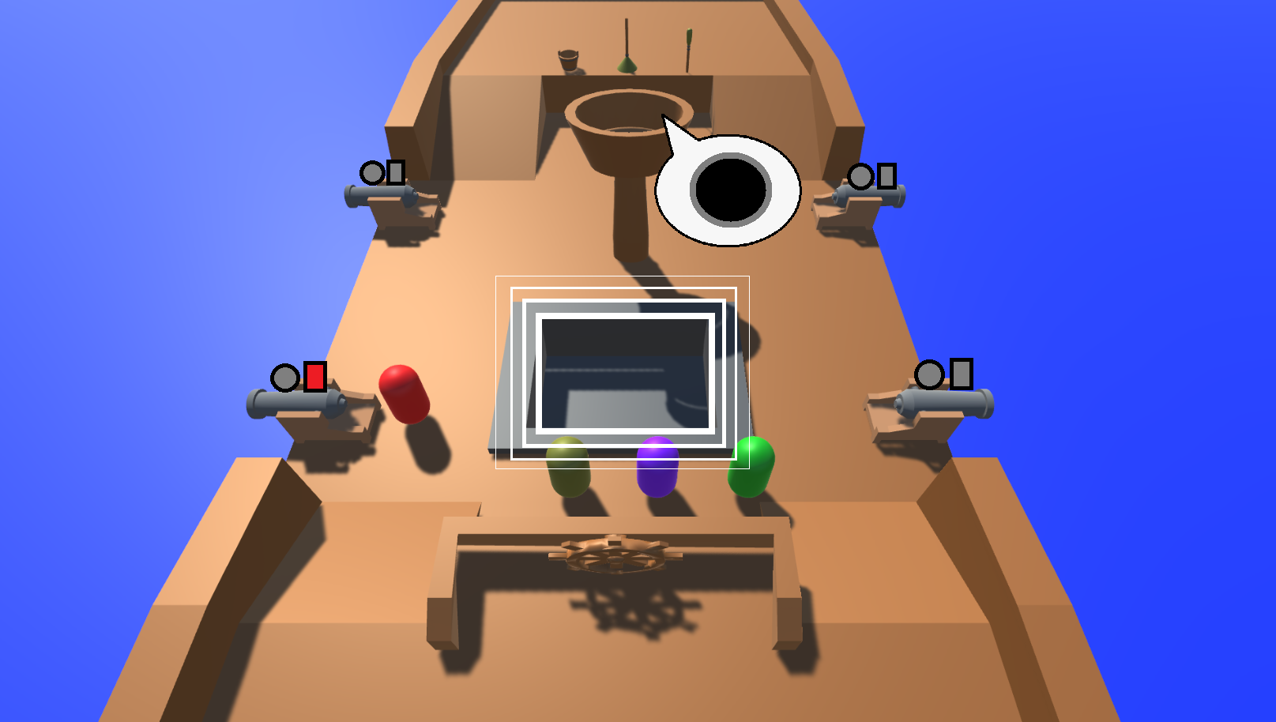
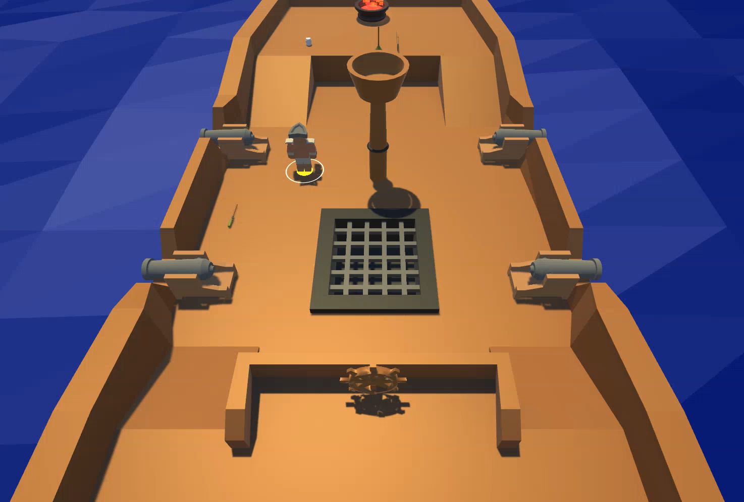
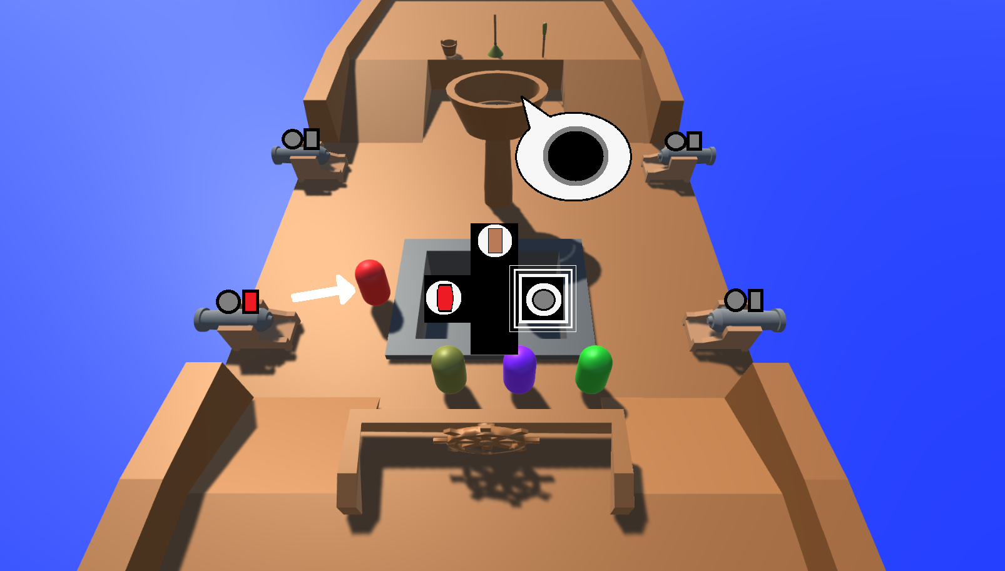
Cannon & UI
Load items into cannon
Use torch to fire cannon

Slide 6
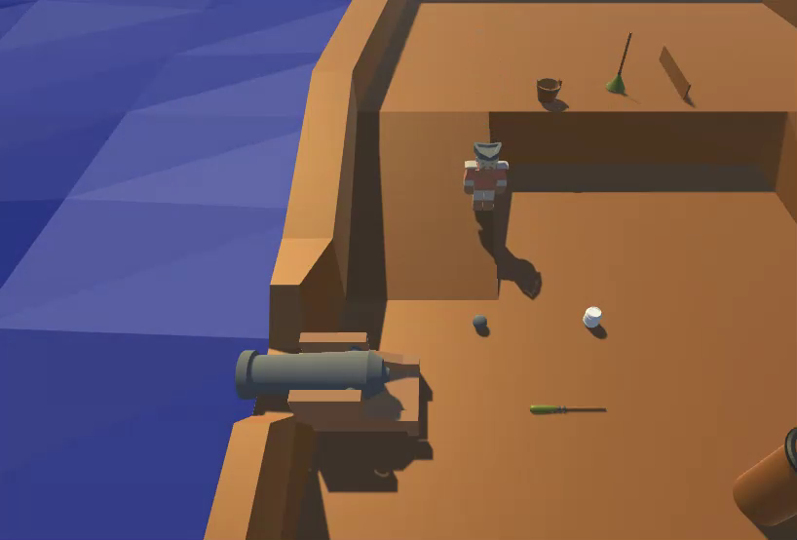
Loading The Cannon

Slide 7
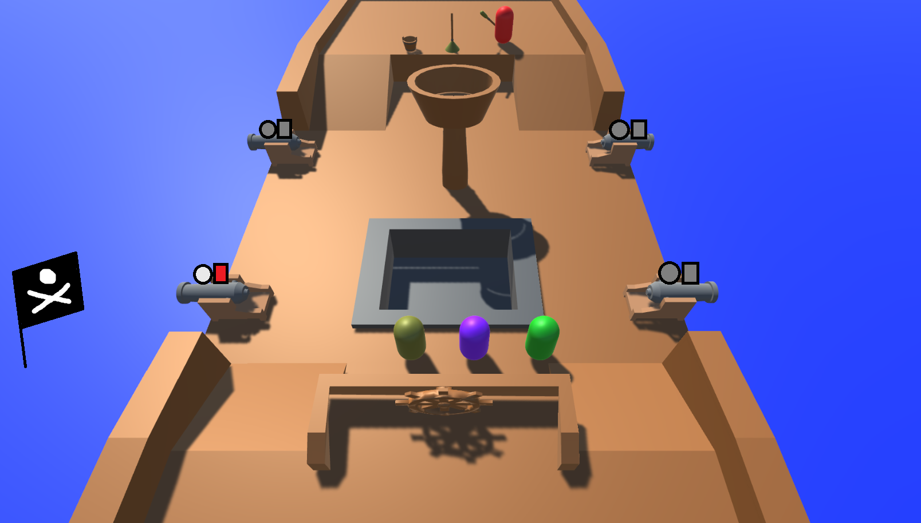
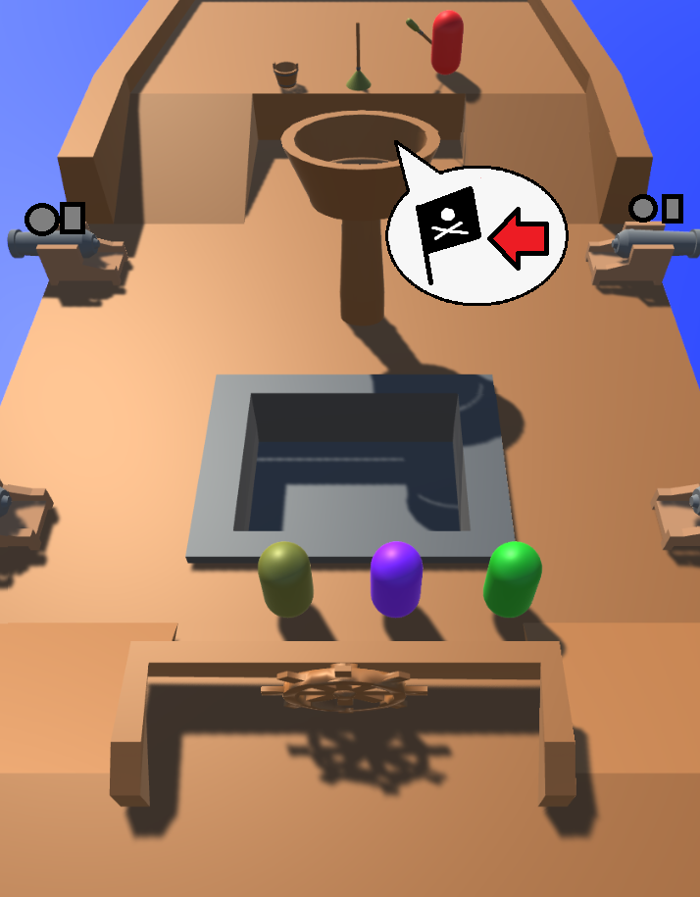
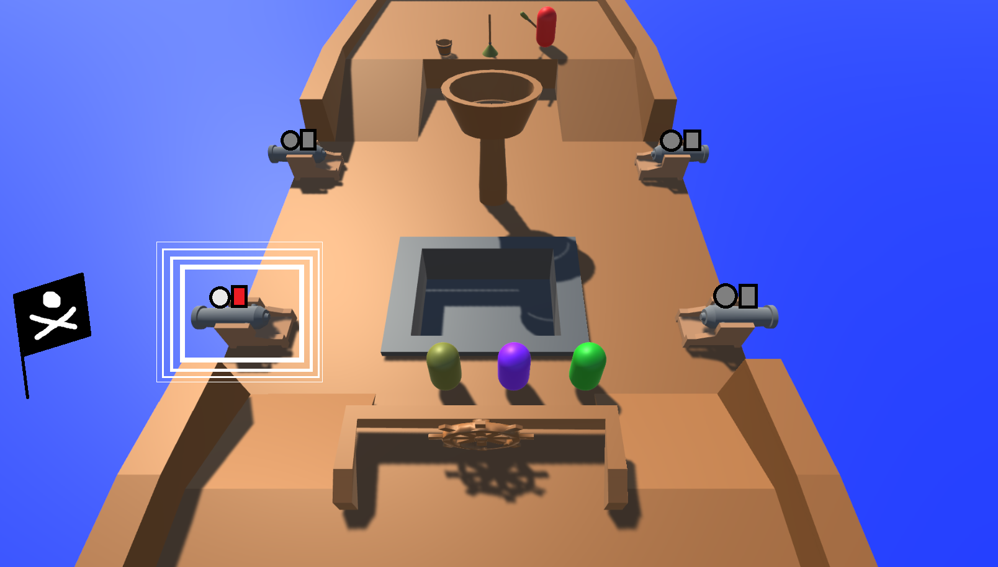
Show Enemy Flag Location

Slide 8
Enemy cannon hit location

Slide 9
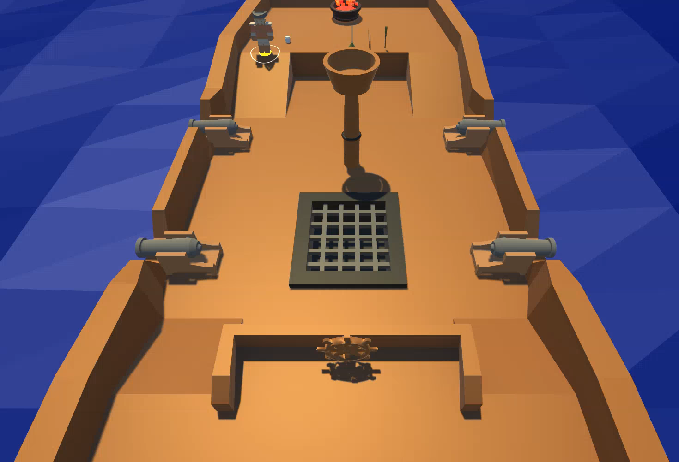
Crow’s Nest Call Outs
Warns players about hazards

Slide 10
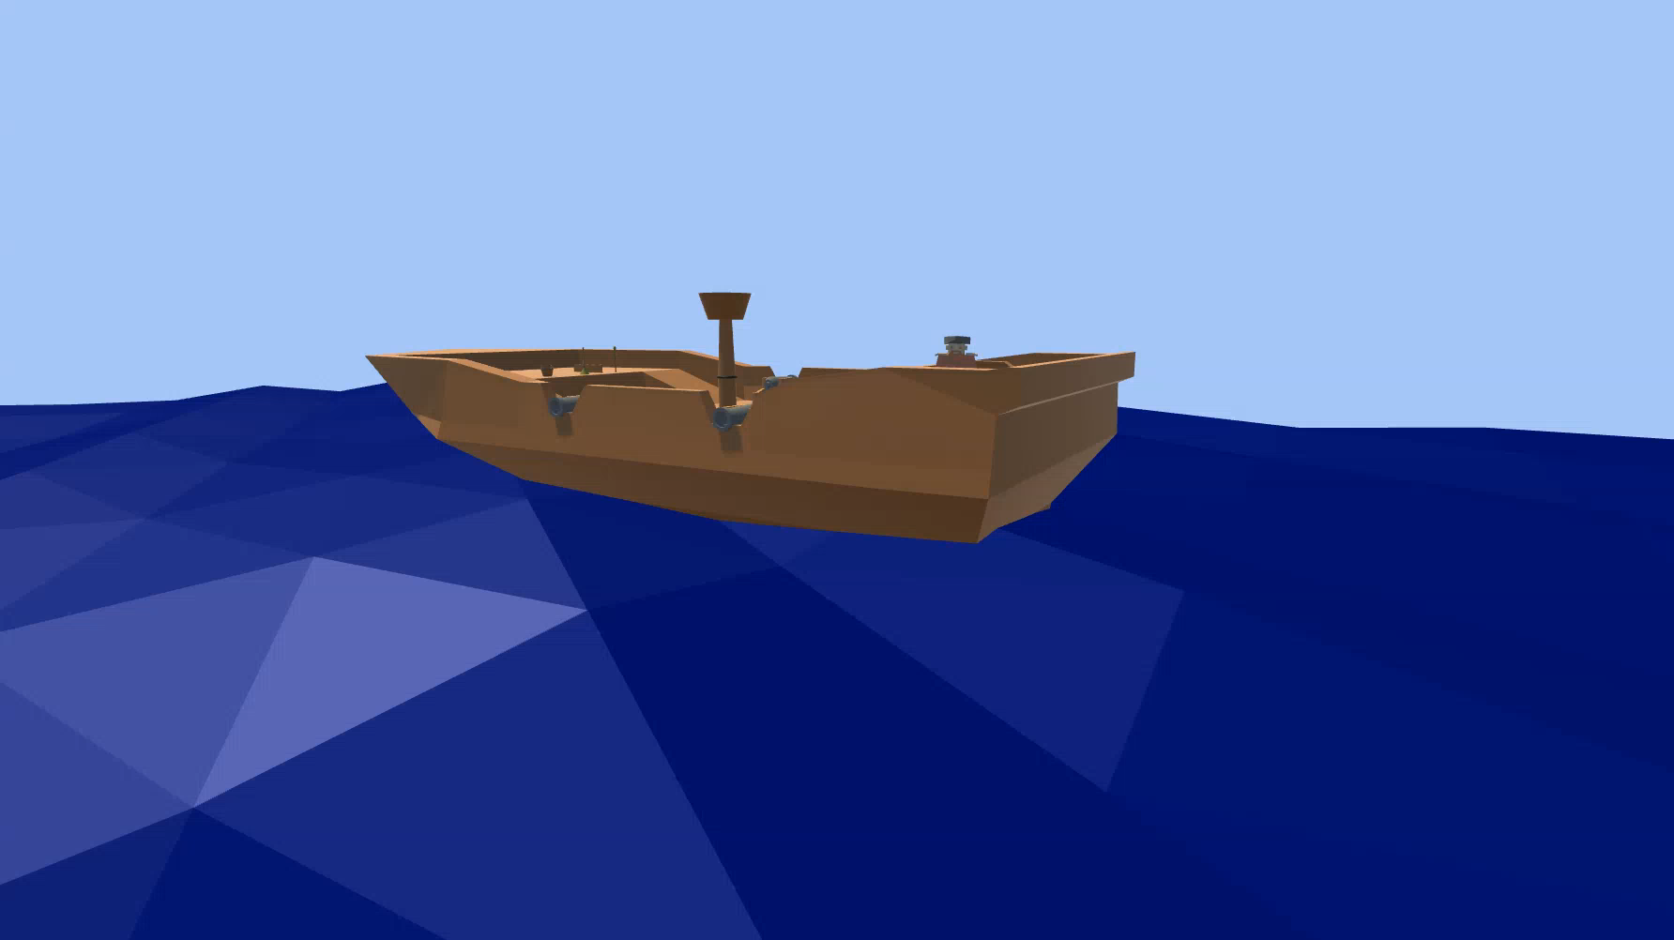
Whale Event

Slide 11
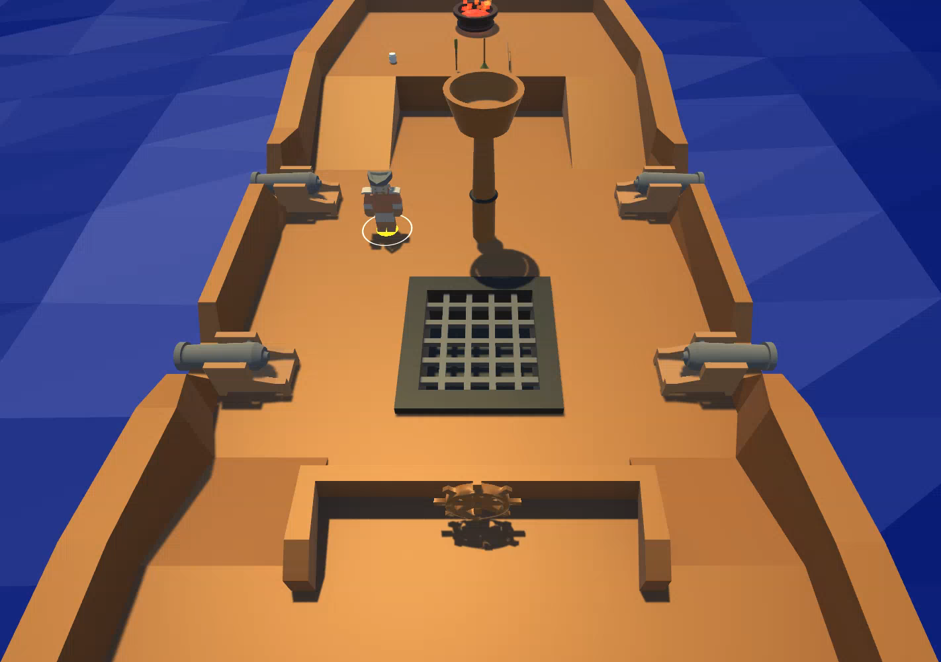
Seagull and Mop

Slide 12
Steering the Ship

Slide 13
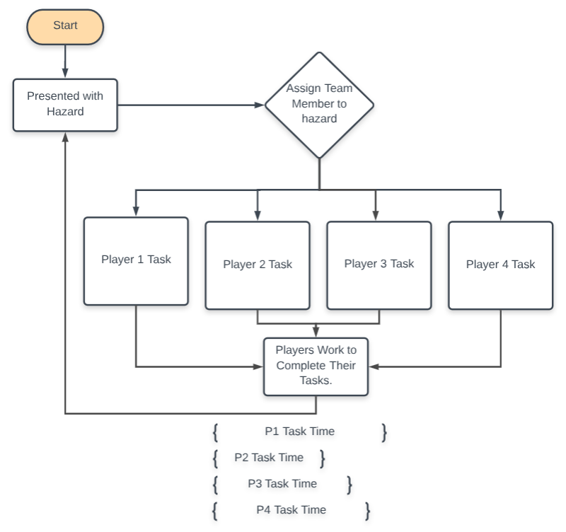
Flow Chart

Slide 14
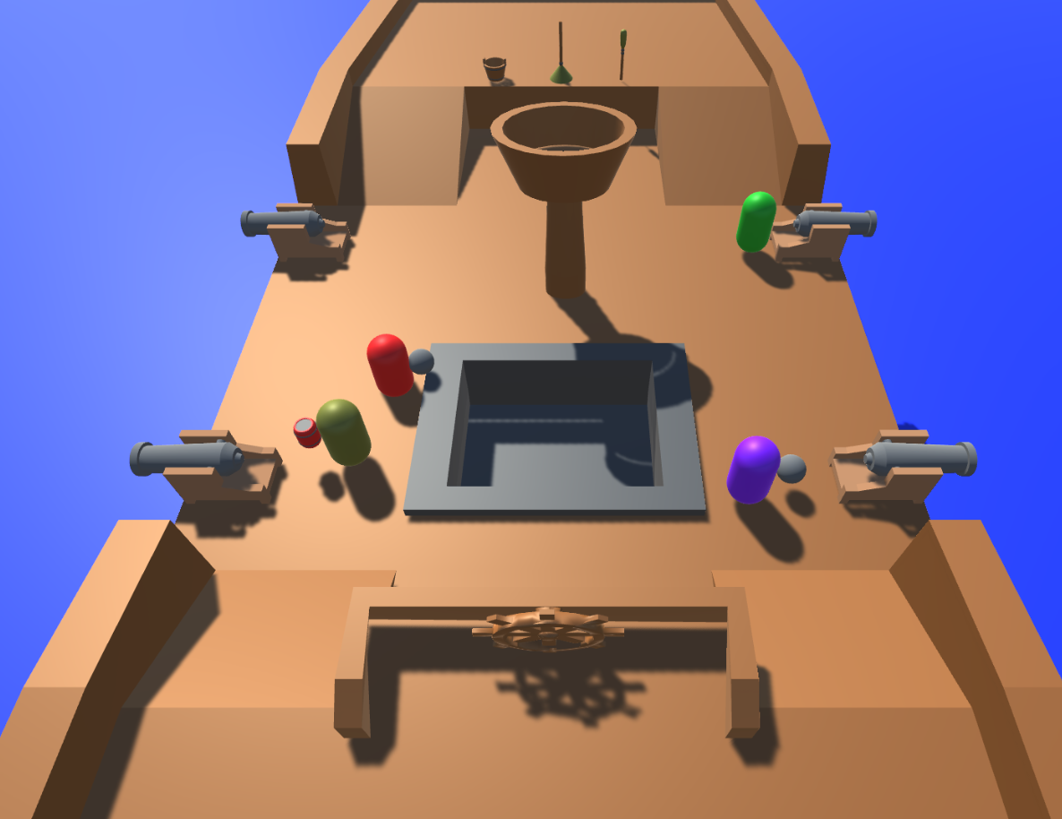
Gameplay: 5 Seconds

Slide 15
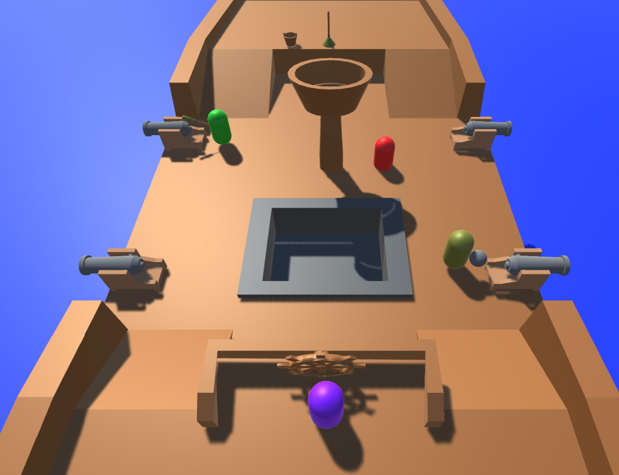
Gameplay: 20 Seconds

Slide 16
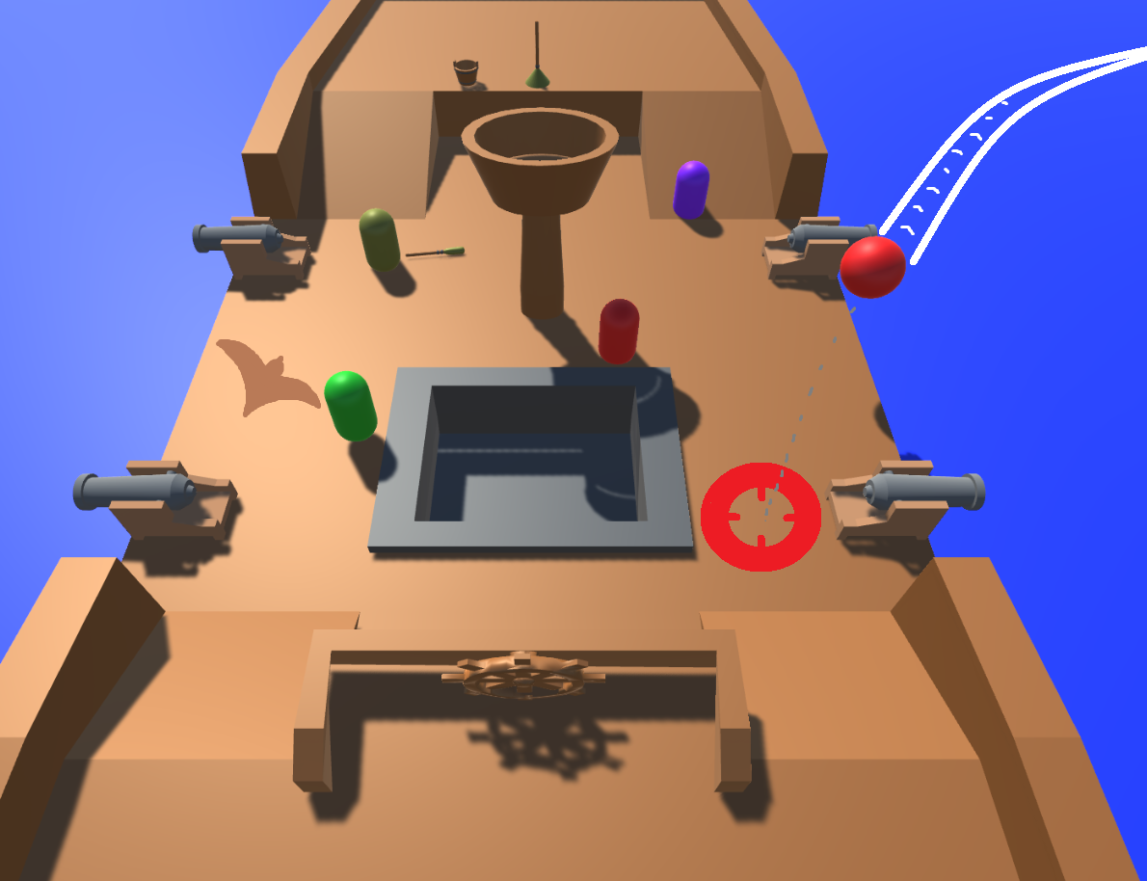
Gameplay: 40 Seconds

Slide 17
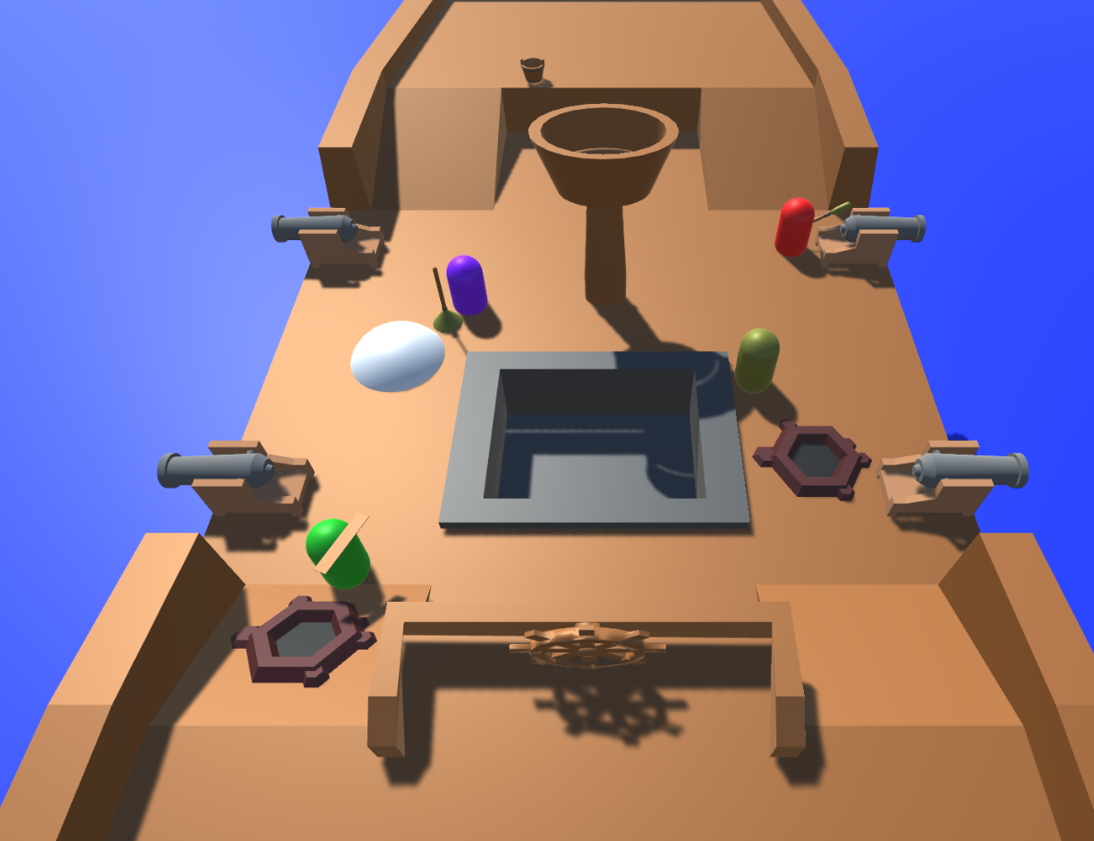
Gameplay: 1 Minute

Slide 18
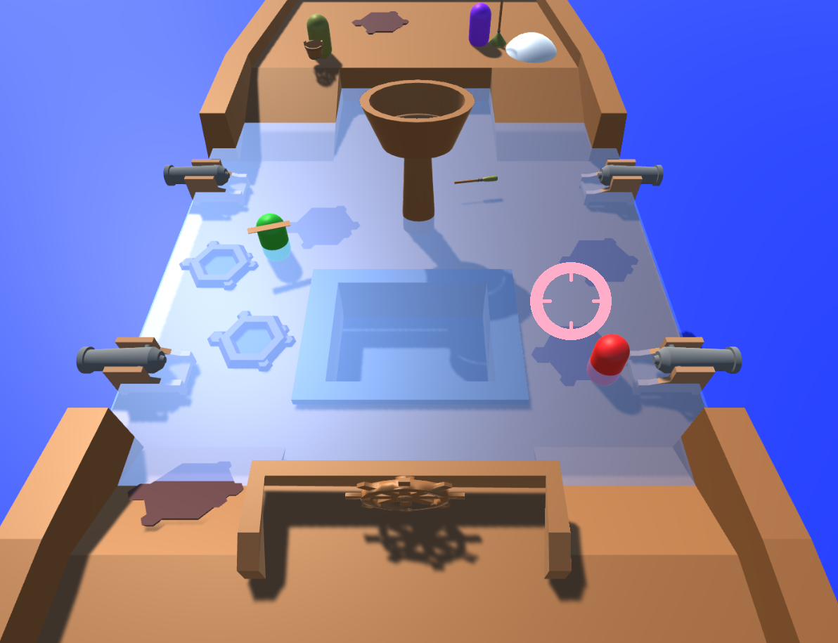
Gameplay: 2 Minutes

Slide 19
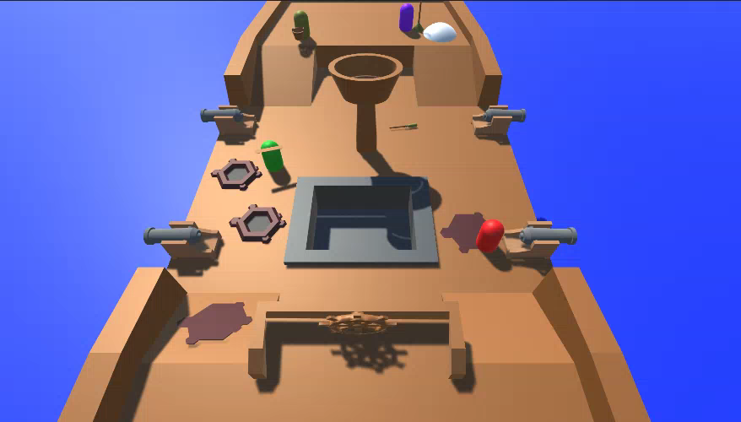
Telegraphing Ship Health

Slide 20
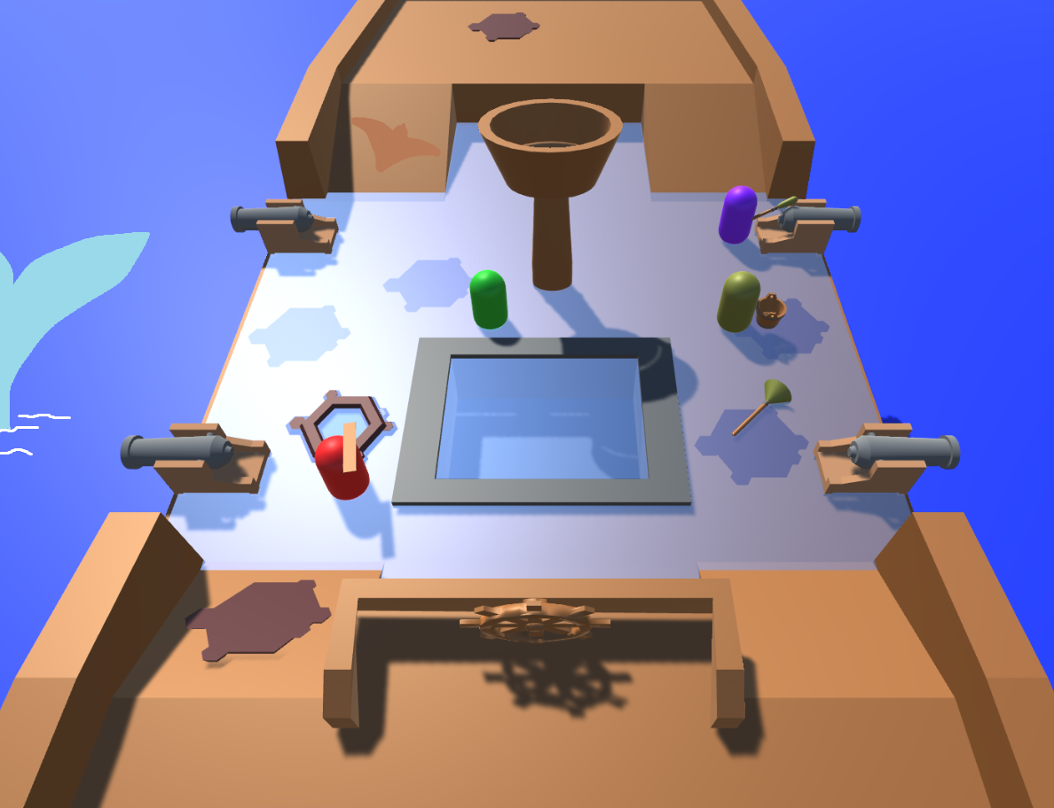
Gameplay: 4 Minutes

Slide 21
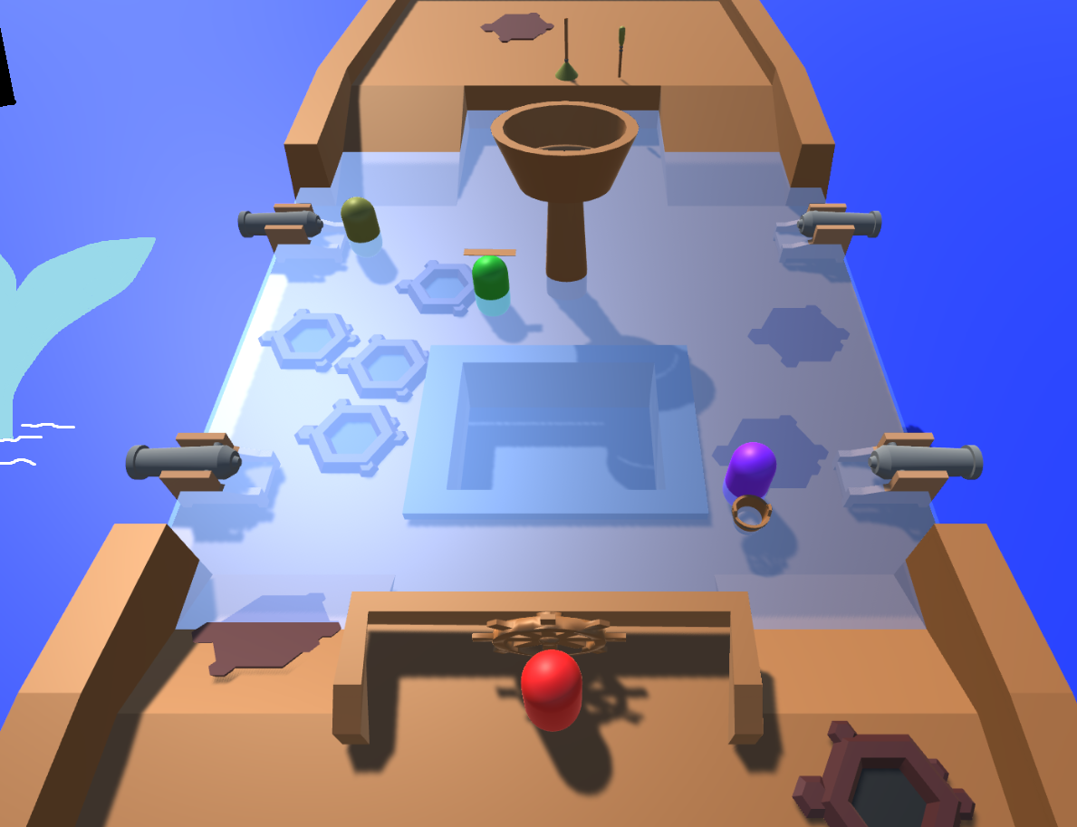
Gameplay: 5 Minutes

Slide 22
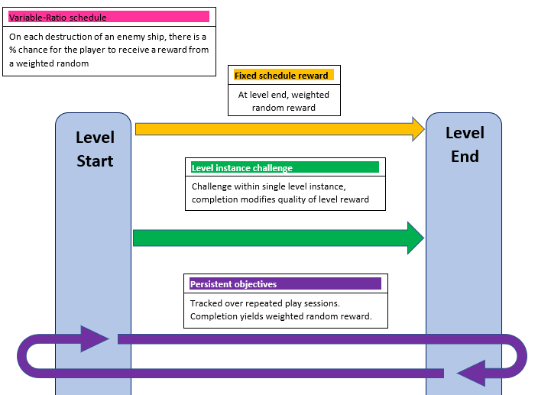
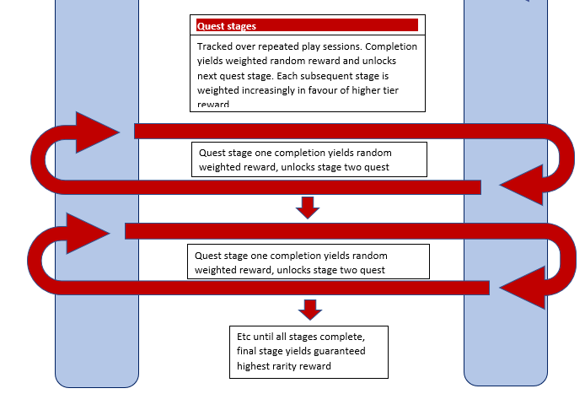
Reward Schedules

Slide 23
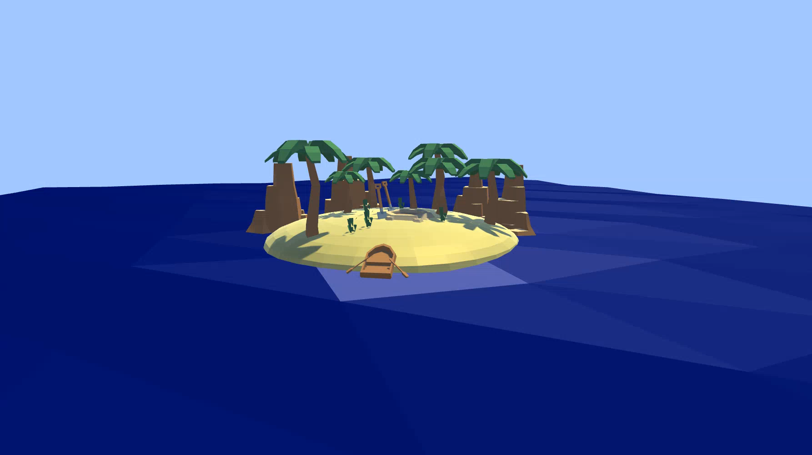
Rewards Animation

Slide 24
How the Game has Developed
Updated mechanics
All mechanics implemented (independently)
Animation sequence
Updated existing assets
Implemented assets for new mechanics

Slide 25
Work Completed
For sprint 8: Tom: estimated 12h 50m - logged 13h 15m | Henry: estimated: 12h - logged: 11h 10m
For sprint 9: Tom (12h estimated – 10h 35m) | Henry: (11h 30m estimated - 10h 10m logged)
For sprint 10: Tom (13h estimated – 13h 15m) | Henry: (12h 15m estimated - 12h 30m logged)
For sprint 11: Tom (11h 30m estimated – 14h 30m logged) | Henry: (12h 30m estimated – 13h 45m logged)
TOTAL (OVER 4 WEEKS)
Tom: 51hours 35minutes
Henry: 47hours 25minutes
Difference can be put down to Player UI task + production of 3D models/animations.

Slide 26
Plan for Christmas Vacation
Collate work - ensure all compatible, bug free
Game managers
Be in position for playtesting
Once achieved can implement TUTORIAL / ‘saving’ / customisation / character select / rewards / quests

Slide 27
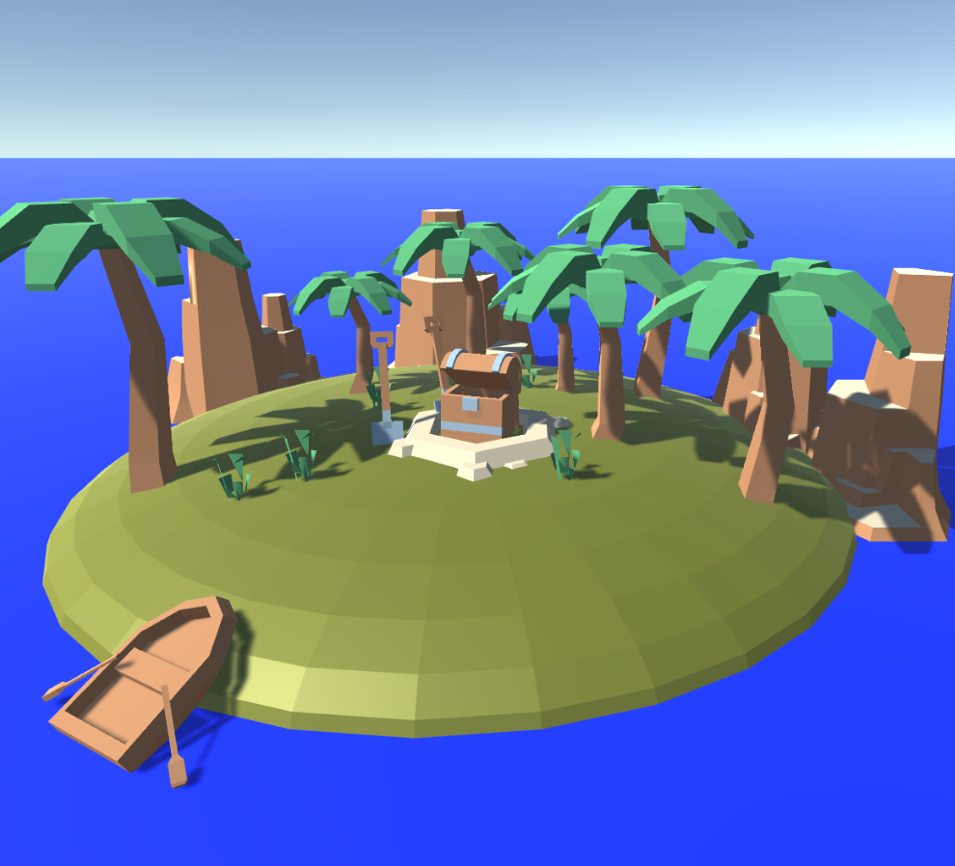
Questions?

